Slide 1
Phase 1 Data Project
Kelvin Sesery

Slide 2
Problem Statement: Aircraft Purchase Data Analysis for Commercial and Private Aviation
Objective: Identify the safest aircraft models for commercial and private operations. Analyze accident by aircraft make and model , flight phase and purpose of flight
Analysis Performed
Safety by Aircraft Model Grouped by make and model to calculate: Total accidents Fatal accidents Fatal accident rate (%)
Accident Trends : Accidents over time by purpose of flight Accidents by broad phase of flight
Business Recommendations Which aircraft to buy/lease

Slide 3
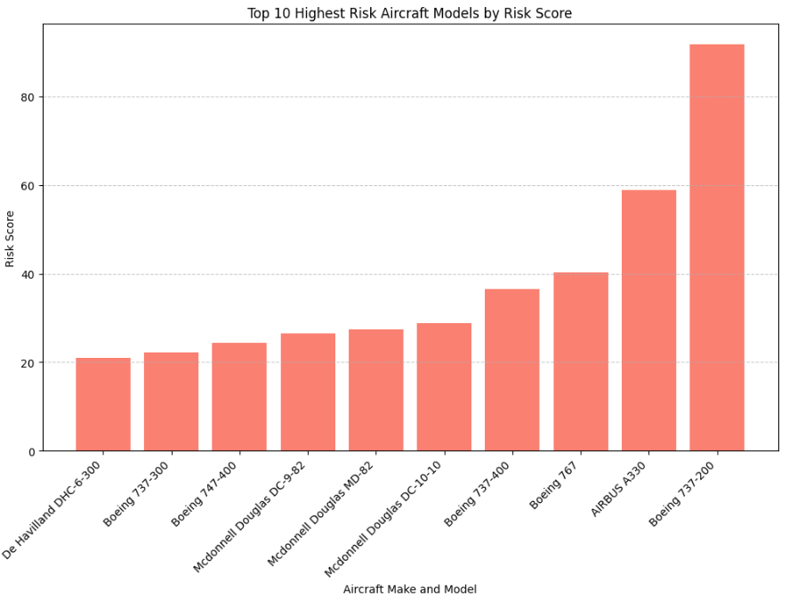
Highest Risk Aircraft By Models
Based on the risk indicator = (The number of incidents count + the count of injury experienced ) * Weightage on the fatality of the injuries
The Boeing 737-200 had the highest possibility of damage followed by the Airbus A330 and the Boeing 767.
For entry level for commercial purposes and fatality of both plane damage and people the company should not purchase the listed aircraft models

Slide 4
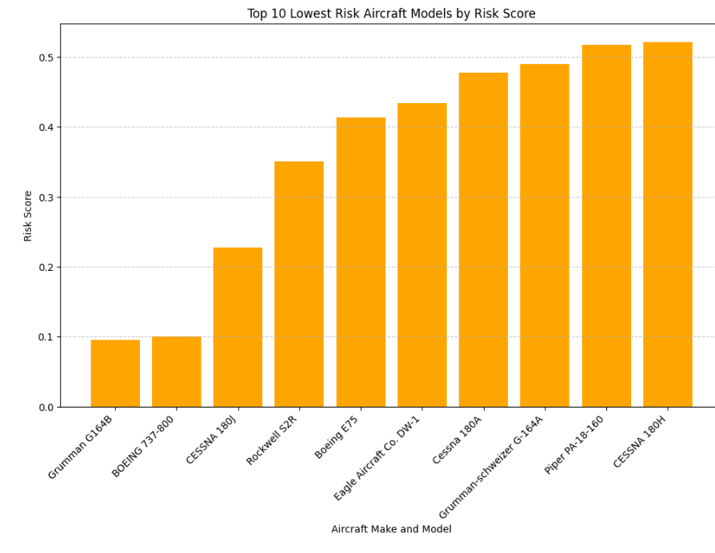
Lowest Risk Aircraft By Models
Based on the risk indicator = (The number of incidents count + the count of injury experienced ) * Weightage on the fatality of the injuries
The Grumman G164B is the least risk aircraft followed by Boeing 737-800 and CESSNA 180j
For entry level the listed aircrafts will be the least risk and assurance of any accident occurrence and fatality

Slide 5
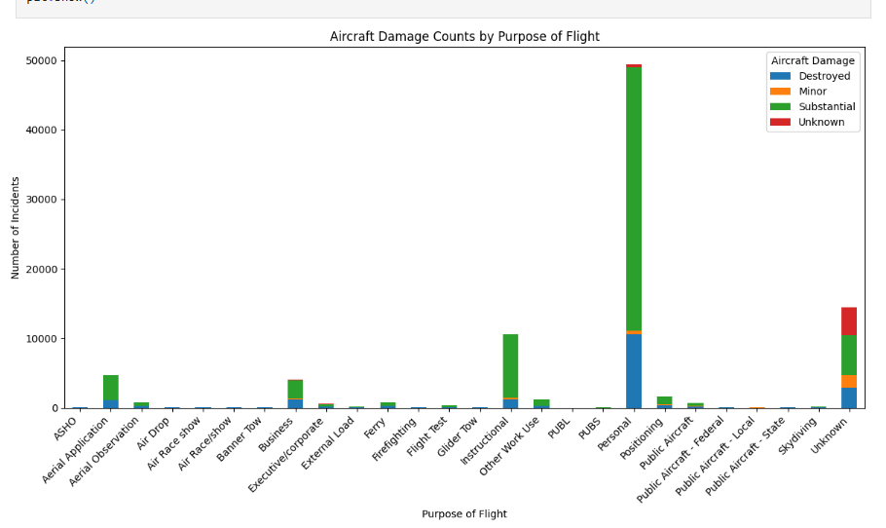
Aircraft Damage by Purpose of Flight
The highest damage is aircraft damage is from personal fright are substantial
Also major items are destroyed
More focus to be on personal flight and the requirements need for business around personal flight
This also accounted for the highest % of destroyed aircraft damage
The entry introduction should be business with less risky scenario

Slide 6
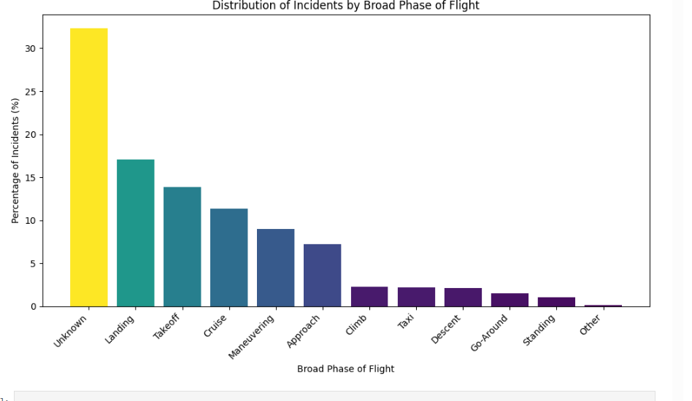
Incidents by Phase of Flight
The most common scenario of possible incident is not categorized and need to have all incidents report categorized
The landing is the followed up reason for the most common occurrence followed by Take off, cruise and maneuvering
The listed scenarios should be the most skill building activity for pilots and associated staff on support
In acquiring manpower this should be the most expertise field of check and verification to eliminate possible incidents that

